Slide 1
End To End
Javascript Testing
Anne Bougie
Skyline Technologies

Slide 2
Why Write Tests?
Spend less time in the browser hitting F5
Have confidence that changes do not break seemingly unrelated things
Be able to run tests in multiple environments simultaneously
Show new developers how to use your api

Slide 3
What are we going to cover?
Popular testing tools & frameworks
Utilities to help test code
Server side testing with Mocha
Stubs and Mocks with Sinon
Code coverage with jsCoverage
Client-side testing in the browser with JsTestDriver

Slide 4
Popular Testing Frameworks
Server Side
Mocha
Jasmine
Vows
Buster JS
Karma (test runner)
Browser
JSTestDriver
Qunit (PhantomJS)
YUI Test
Mocha (headless with Zombie)
Jasmine (headless)
Buster JS (in beta)

Slide 5
Server Side
Mocha
  Can run in the browser or on command line
Jasmine
  Includes many functions of sinon
Vows
  Small overhead
Buster
  Includes both server- and client-side testing. Currently in beta
Karma
  Test runner that will work with Mocha, Jasmine and others

Slide 6
Client Side
Karma
  Recently added support for real browsers. Also headless
Zombie
  Super fast!
Phantom JS
  Good for testing web page output. Uses webkit.
JS Test Driver
  Uses real browsers. Integrated with WebStorm

Slide 7
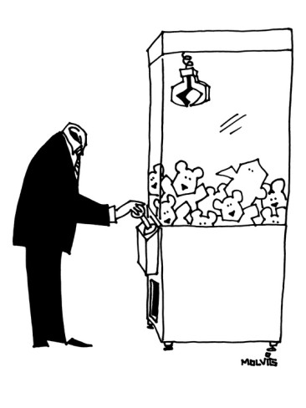
What the heck is a headless browser??

Slide 8
Headless Browsers
Rhino – emulates a browser (Java)
Zombie – emulates a browser (Python)
JSPhantom - (Webkit)
-Matches exactly no production environments
+Allows testing of html output

Slide 9
Other Tools
Sinon – Mocking and Stubbing Library
Should.js – Assertion Library
Rewire – Dependency Injection Tool
JsCoverage – Code Coverage Reporting
Selenium – Browser Automation
Jenkins/Travis – Continuous Integration

Slide 10
Server-Side Testing with Mocha
Tests asynchronous and synchronous code patterns
Hooks: before, after, beforeEach, afterEach
Pending tests (to easily define tests needed)
only and skip
Many reporters
BDD interface (enhance using should)

Slide 11
Time for Code

Slide 12
Sinon JS
Fake Timers – setTimeout, clearTimeout, setInterval, clearInterval, Date
Test Spies – send in a spy object to determine the behavior on that object
Test Stubs – replace a function with a stub that has predetermined behavior
Mocks – set expectations on objects without replacing its functionality

Slide 13
Time for Code

Slide 14

Masters Of Time

Slide 15

Spy On Your Code

Slide 16

Don't Mock Me

Slide 17
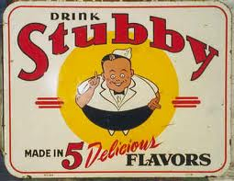
Use Stubs to Control Behavior

Slide 18
Spying, Mocking, Stubbing & Expectations
Spies can be used to determine what behaviors happened
Stubbing replaces objects or functions with a mocked object
Mocking allows expectations to be set and verified
Validate that calls were made
Validate arguments used in calls
Supply a pre-defined return value
Create an error response

Slide 19
Code Coverage
Time for Code

Slide 20
Client-Side Testing with JSTestDriver
Time for Code

Slide 21
JsTestDriver Assertions
assert(msg, value)
assertTrue(msg, value)
assertFalse(msg, value)
assertEquals(msg, expected, actual)
assertNotEquals(msg, expected, actual)
assertSame(msg, expected, actual)
assertNotSame(msg, expected, actual)
assertNull(msg, value)
assertNotNull(msg, value)
assertUndefined(msg, value)
assertNotUndefined(msg, value)
assertNaN(msg, number)
assertNotNaN(msg, number)
assertException(msg, callback, type)
assertNoException(msg, callback)
assertArray(msg, arrayLike)
assertTypeOf(msg, type, object)
assertBoolean(msg, value)
assertFunction(msg, value)
assertNumber(msg, value)
assertObject(msg, value)
assertString(msg, value)
assertMatch(msg, pattern, string)
assertNoMatch(msg, pattern, string)
assertTagName(msg, tagName, element)
assertClassName(msg, className, element)
assertElementId(msg, id, element)
assertInstanceOf(msg, constructor, object)
assertNotInstanceOf(msg, constructor, object)

